Slide 1





Graduation Talk: 28th August 2024
MEME: A theoretical and social journey
Lakshya Chauhan MEME 2022 – 2024

Slide 2

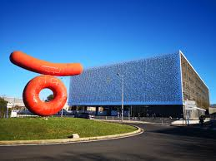
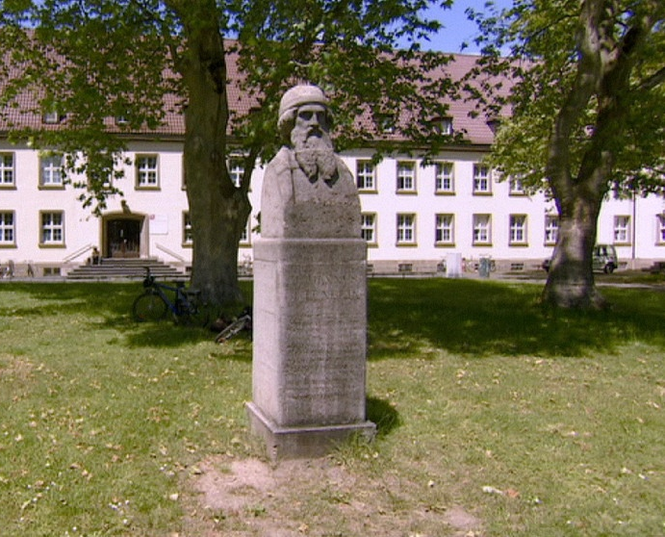





My meme journey (spatial)
Groningen
Montpellier
Mainz
Jan Kreider
Dr. Luis-Miguel Chevin
Prof. Hanna Kokko
Dr. Ido Pen
Dr. Margaux

Slide 3
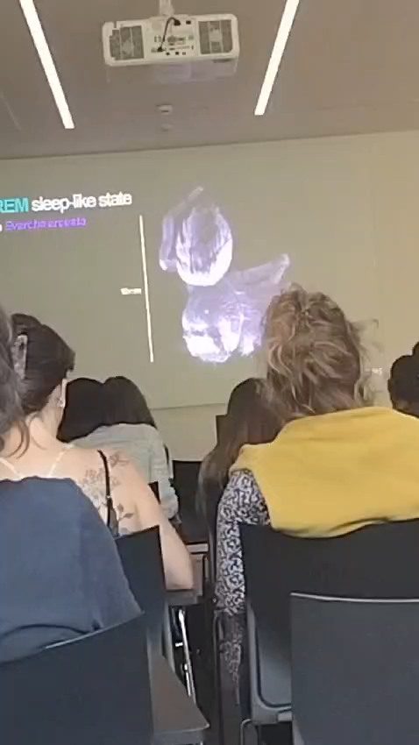


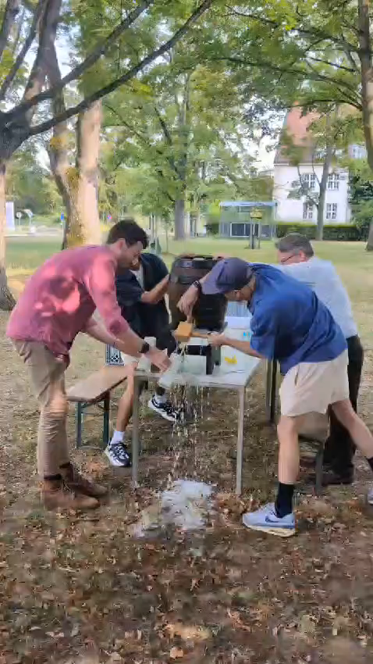
A theoretician’s paradise

Slide 4
Behind Enemy Lines: Investigating Crozier’s Paradox and Recognition of Nestmates through an Individual-Based Model

Slide 5
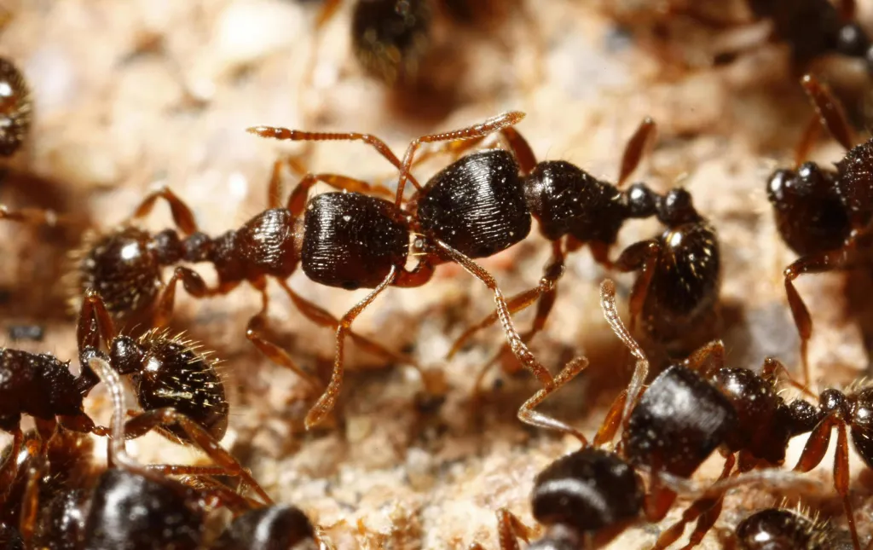
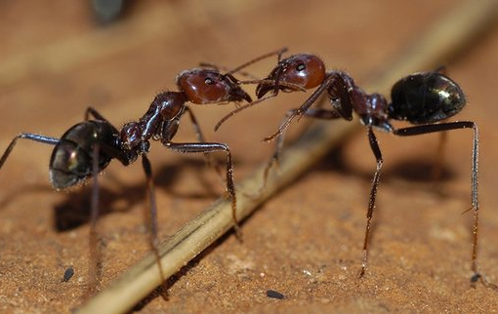
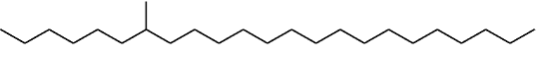
Nestmate recognition in ants
War?
Peace?
Cuticular Hydrocarbons (CHCs)
Sturgeon & Gordon., 2012 Martin & Drijfhout., 2009

Slide 6

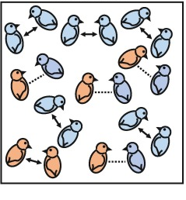

Crozier’s Paradox
Alternate selection pressures?
Genetic kin recognition system exists?
Yes
Benefits to relatives/Costs to non-relatives?
Rossiter H. Crozier
Yes
Loss of diversity?
Only genetic basis to recognition
Random mating
No spatial organization
Yes
Loss of recognition system
Sea Anemones
Crozier., 1986 Scott et al., 2022

Slide 7





Solutions to Crozier’s Paradox
Opposing selection pressure in resource acquisition?
Disassortative mating
Steal from nest
Pleiotropy
Rejected
Beard chromodynamics
Not for ants!
Decoupling CHC profile and perception
Multiple social encounters before interaction
Holman et al., 2013 Leonhardt et al., 2016 Scott et al., 2022
Notes:
1)
2) Parasitism needs to evolve super fast
3) Second, it has been shown theoretically that genetic kin recognition can be stable even without multiple social encounters, if there is: extreme spatial structure (low migration); tight linkage between the tag locus and the helping (trait) locus; strong selection. This hypothesis has been called ‘beard chromodynamics’ because of its reliance on physical tag-trait linkage, which is a characteristic of greenbeard genes.

Slide 8
Model

Slide 9
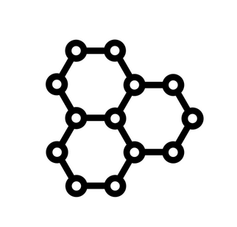
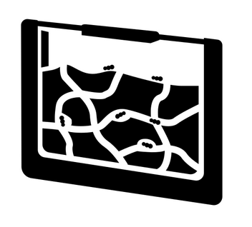
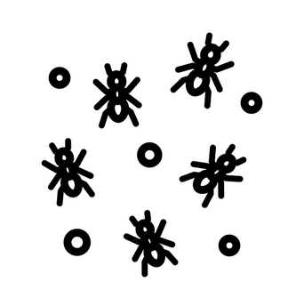


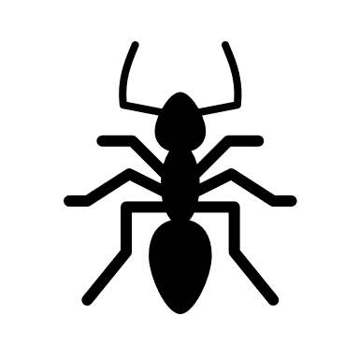

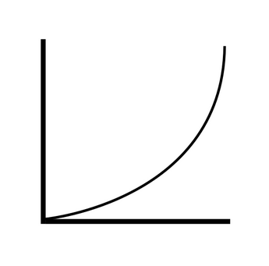
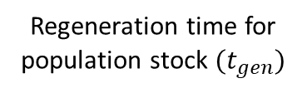
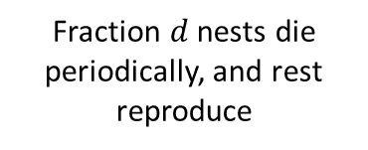
Setup and Lifecycle
Can forage from population stock/steal
Choice to steal/forage depends on distribution of food between population and nest stocks
Fraction $d$ nests die periodically, and rest reproduce
If nest stock goes negative, it dies
Cue profile (10 Cues)
Simulated time
50 Nests
10 Workers
Food acquired is used to produce CHCs (metabolic costs)
Regeneration time for population stock $(t_{gen})$
Gillespie’s algorithm utilized for worker action times
Recognition curve

Slide 10
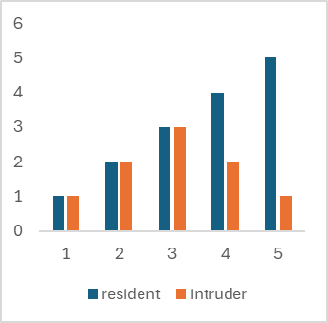
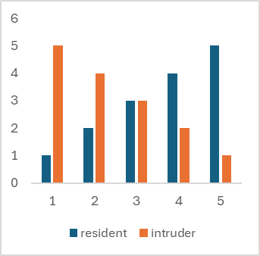
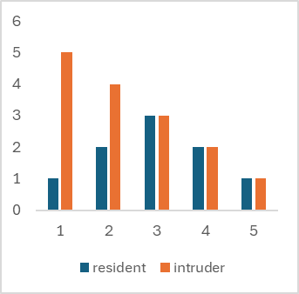
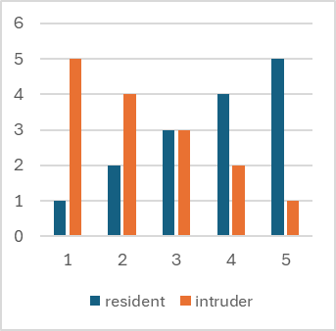
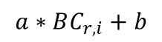
Recognition system
Can cue diversity persist under the scope of our assumptions contrary to what Crozier’s paradox says?
Undergo mutation and inheritance if co-evolving with cues
Desirable-present
$$a∗BC_{r,i}+b$$
Undesirable-absent
Rejection probability
Chemical distance
If accepted, they steal/deposit a food unit
Gestalt

Slide 11
Results 1: Evolving Cues, Non-evolving recognition system

Slide 12
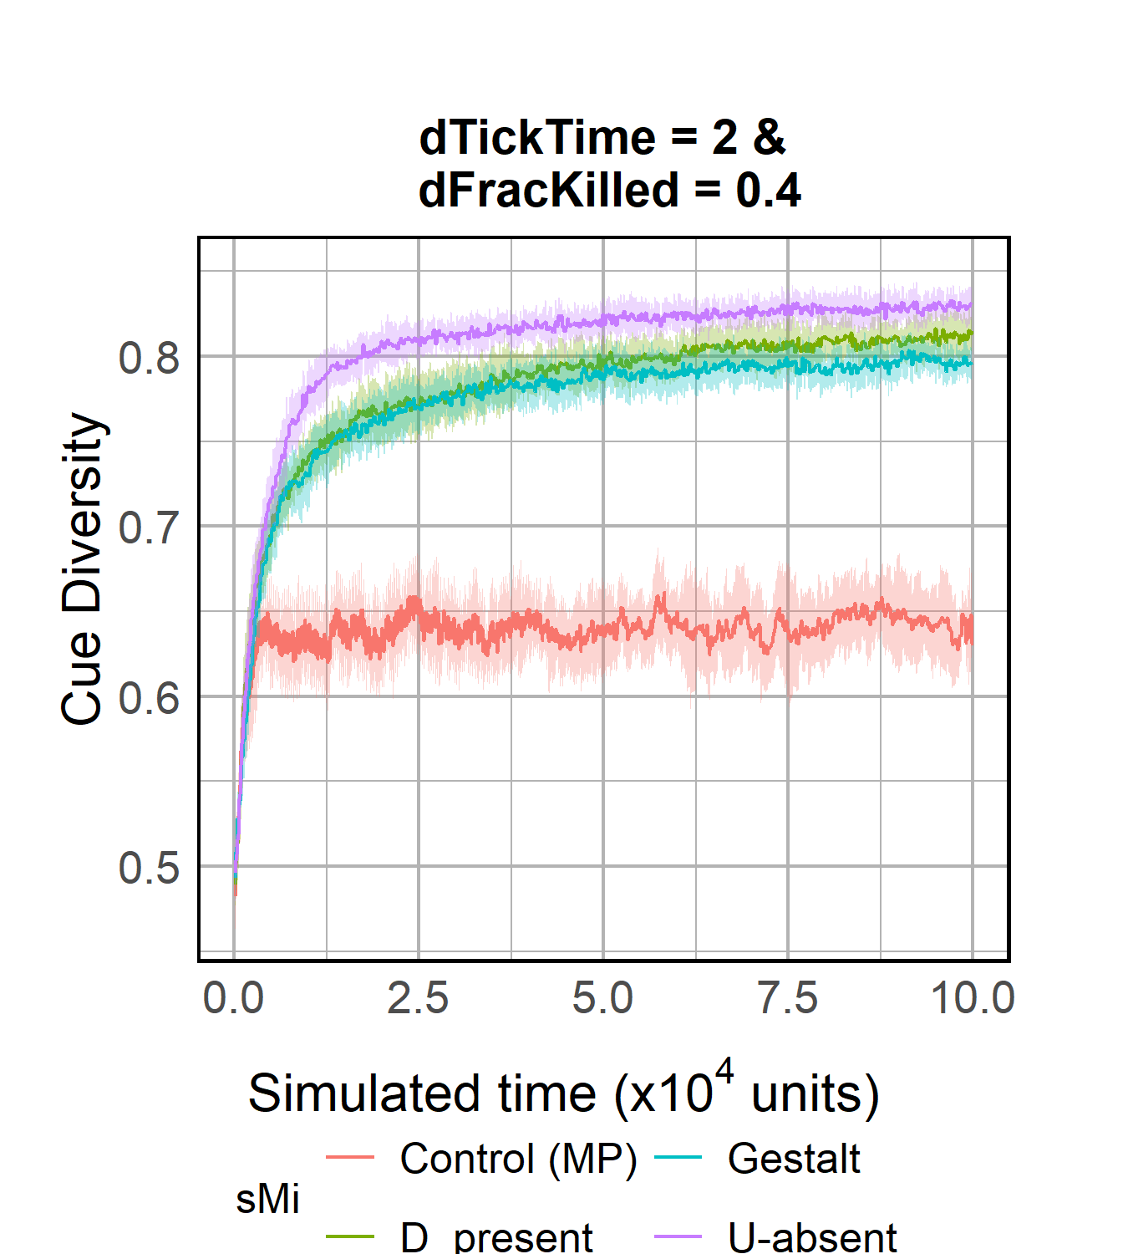
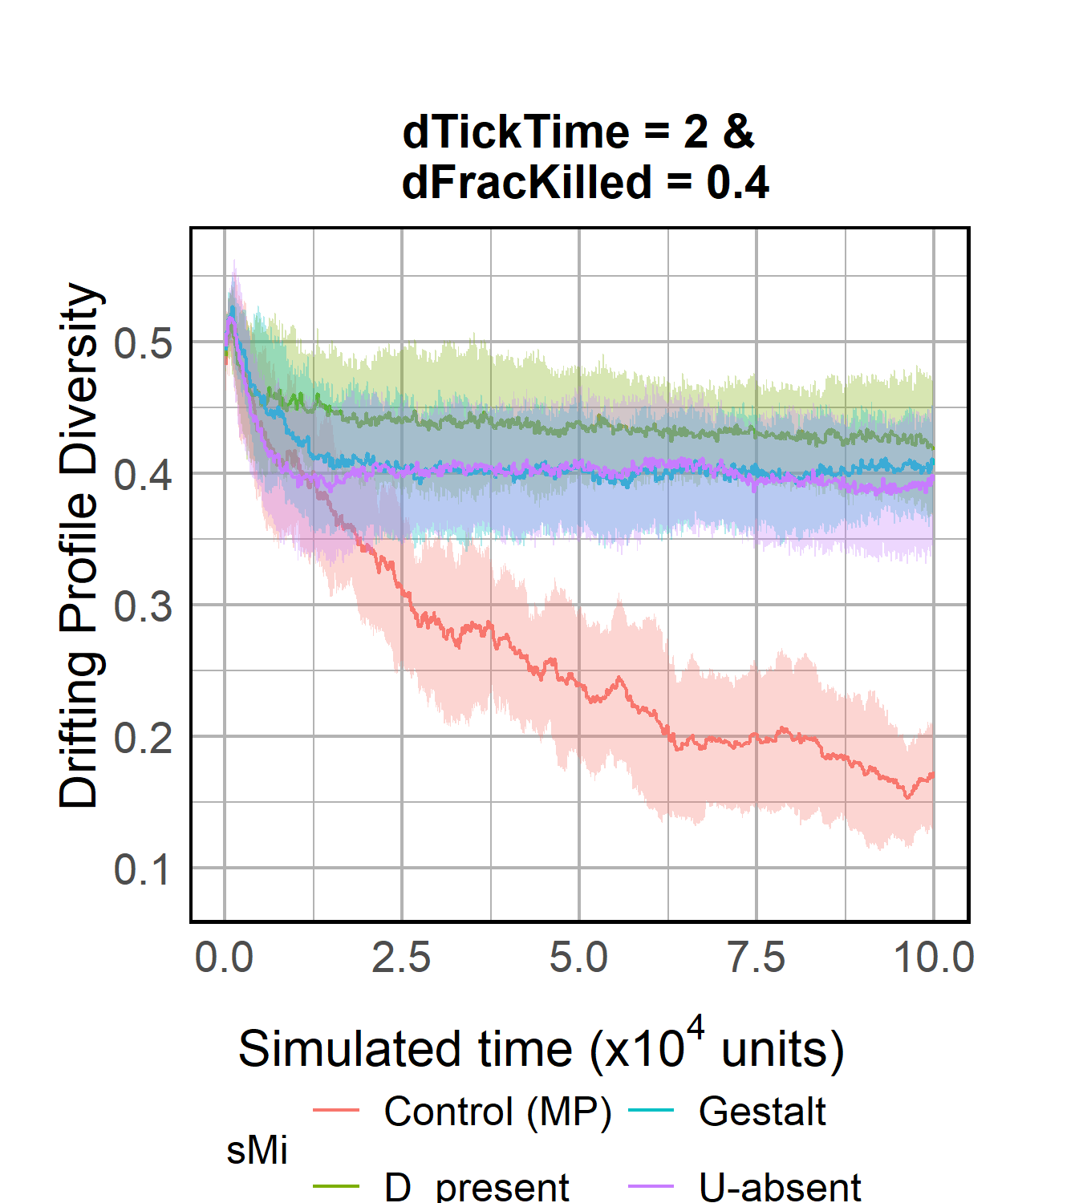
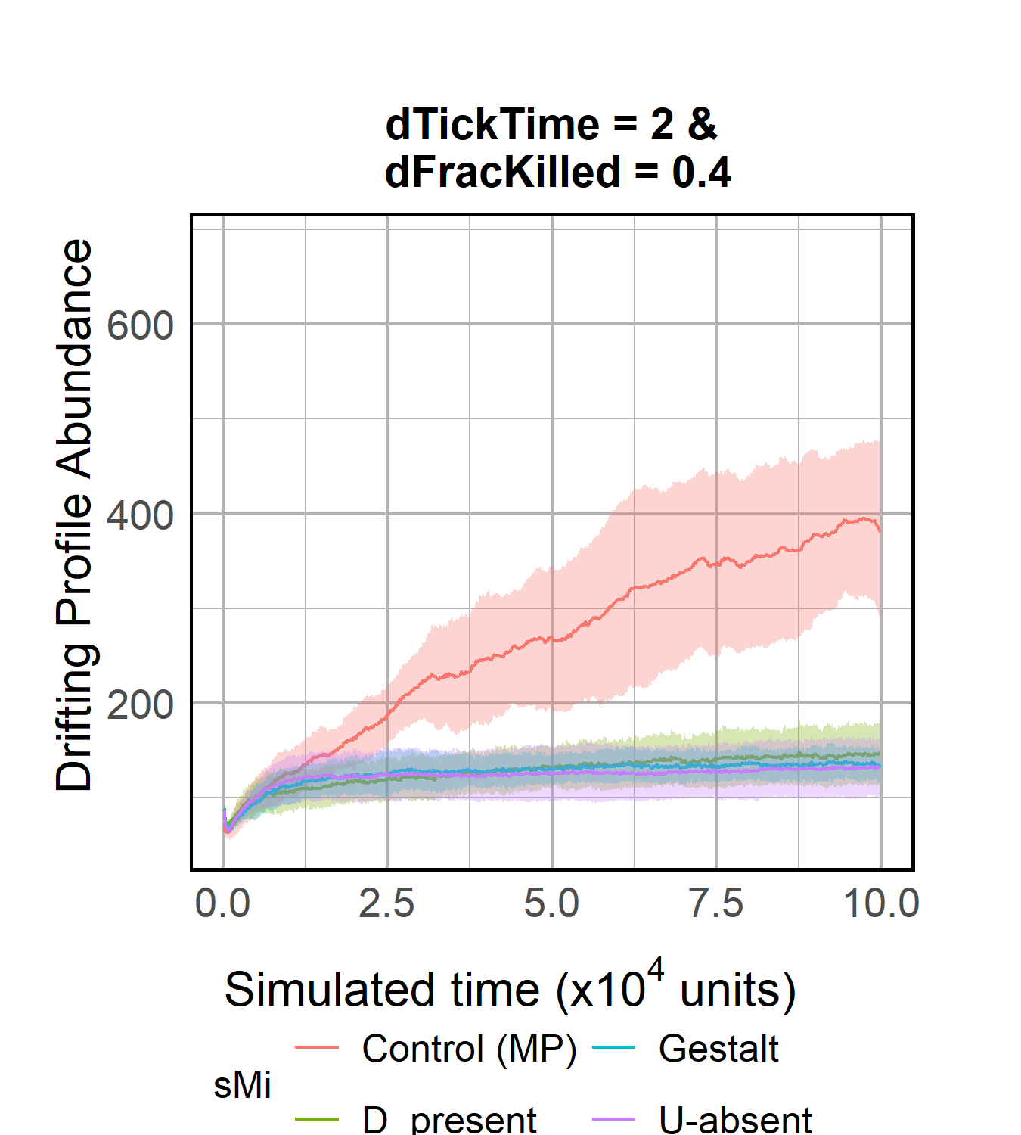
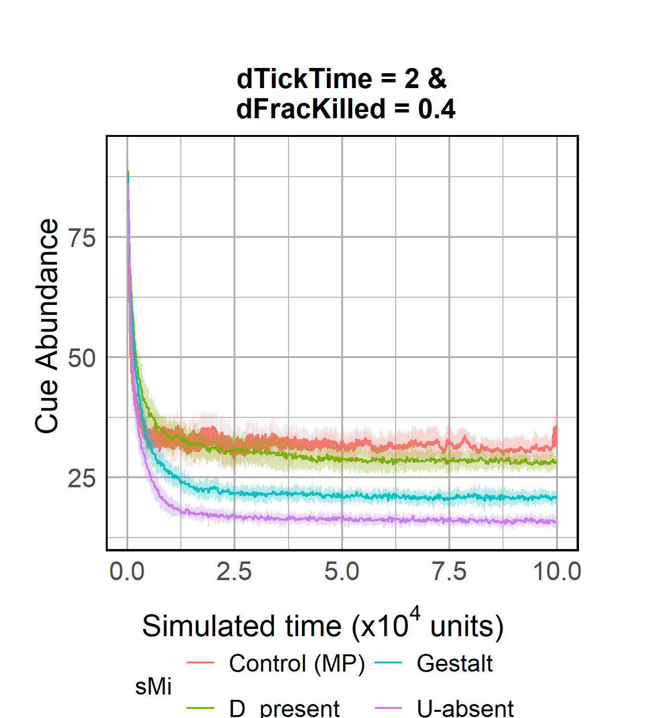
R1: Robust Scenario, High cue diversity maintained!
Higher Cue-diversity and lower Cue-abundance evolved
Cue-diversity can persist even if a single lineage survives
D-present and U-absent models have higher diversity success in stealing than Gestalt model
Notes:
NUMBER OF CUES
Generalist vs Specialist

Slide 13
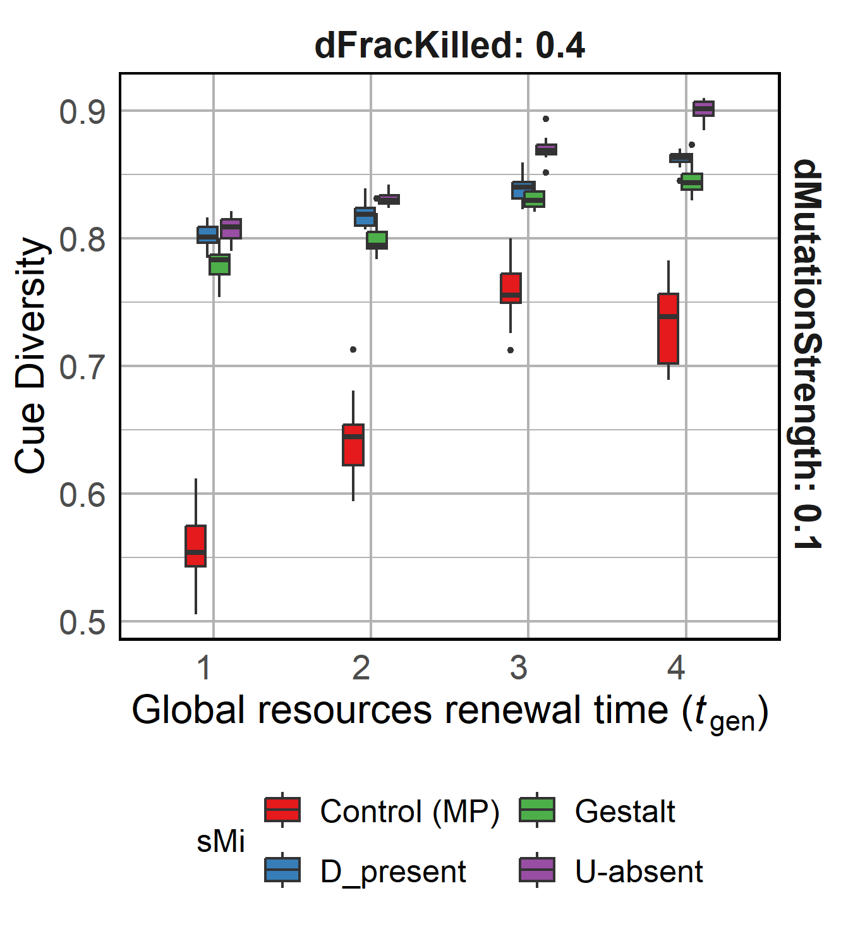
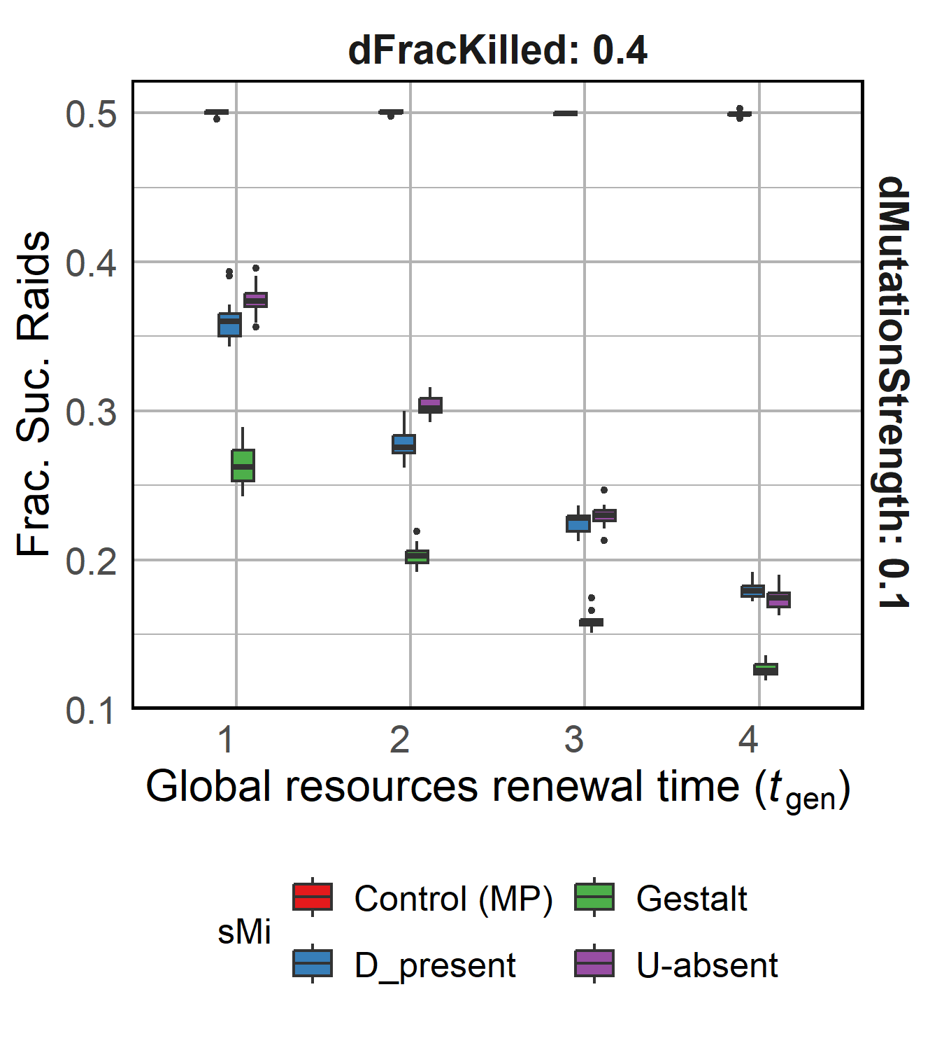
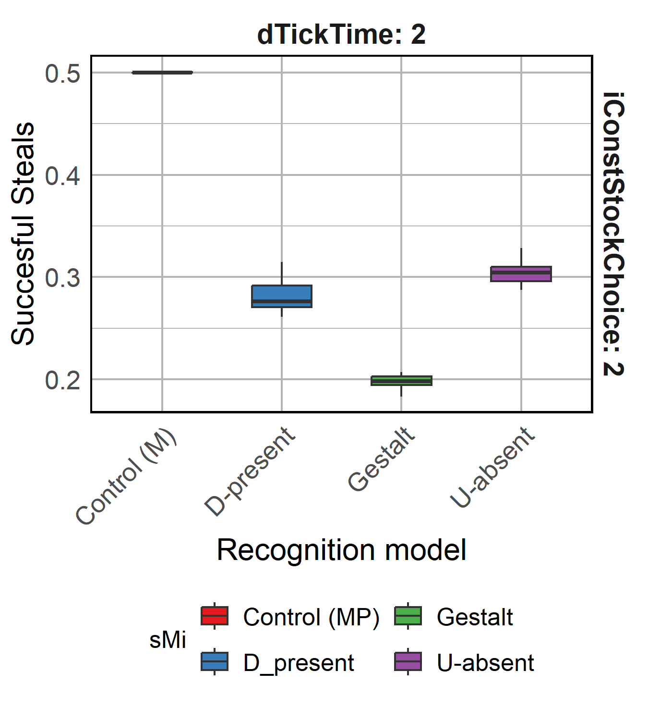
R1: Increased starvation increases colony defence
Increasing starvation
Increasing starvation
Starvation causes more stringent defence from invading workers
U-absent and D-present have higher cue diversity and raiding success
D-present model affected the most by reduced food availability
Notes:
NUMBER OF CUES
Generalist vs Specialist

Slide 14
Other parameters varied…
D-present affected the most by metabolic costs and mutation strength
Same trends observed for continuous food availability (instead of discrete pulses)
D-present models experienced extinction the most amount of times
We also saw all 0 cue profiles evolve (social parasitism by loss of chemical cues)
Varied:
Mutation strength
Metabolic costs
Seasonal mortality
(and others)

Slide 15
Results 2: Co-evolving cues and recognition system
Yes, cue diversity can persist in the presence of an evolved recognition system!!
Can cue diversity and a corresponding recognition system co-evolve?

Slide 16
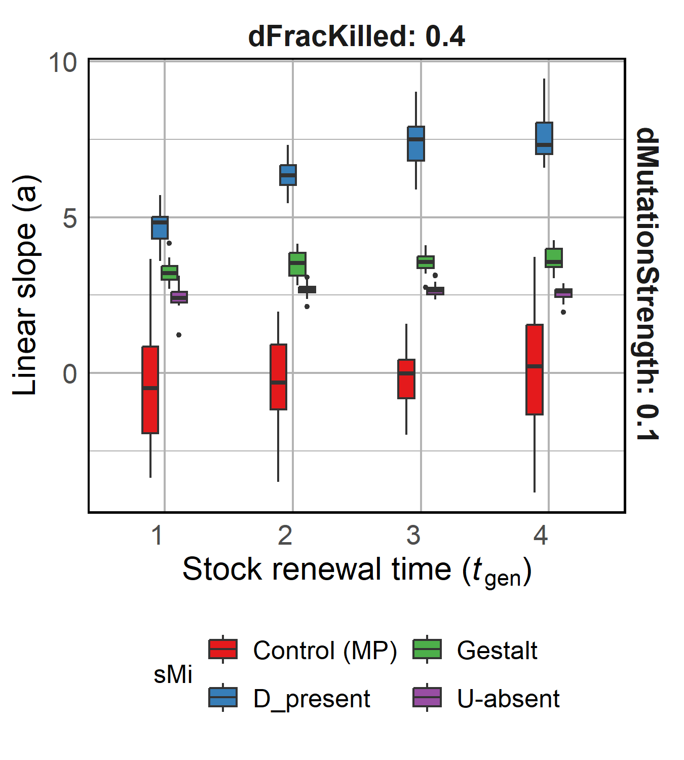

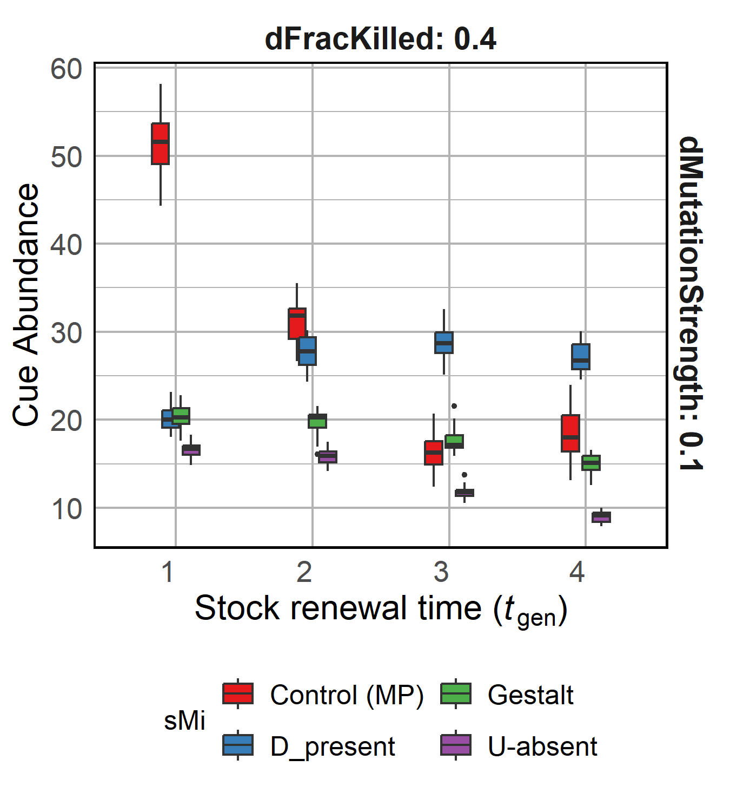
R2 Stringent recognition curve evolves
Yes, cue diversity and a corresponding recognition system can co-evolve!!
Decreasing food availability
A stringent cue recognition system evolves, where availability of food does not affect slope for models values except for D-present.
Rejection probability
Chemical distance
Notes:
< Mention low stealing value >

Slide 17
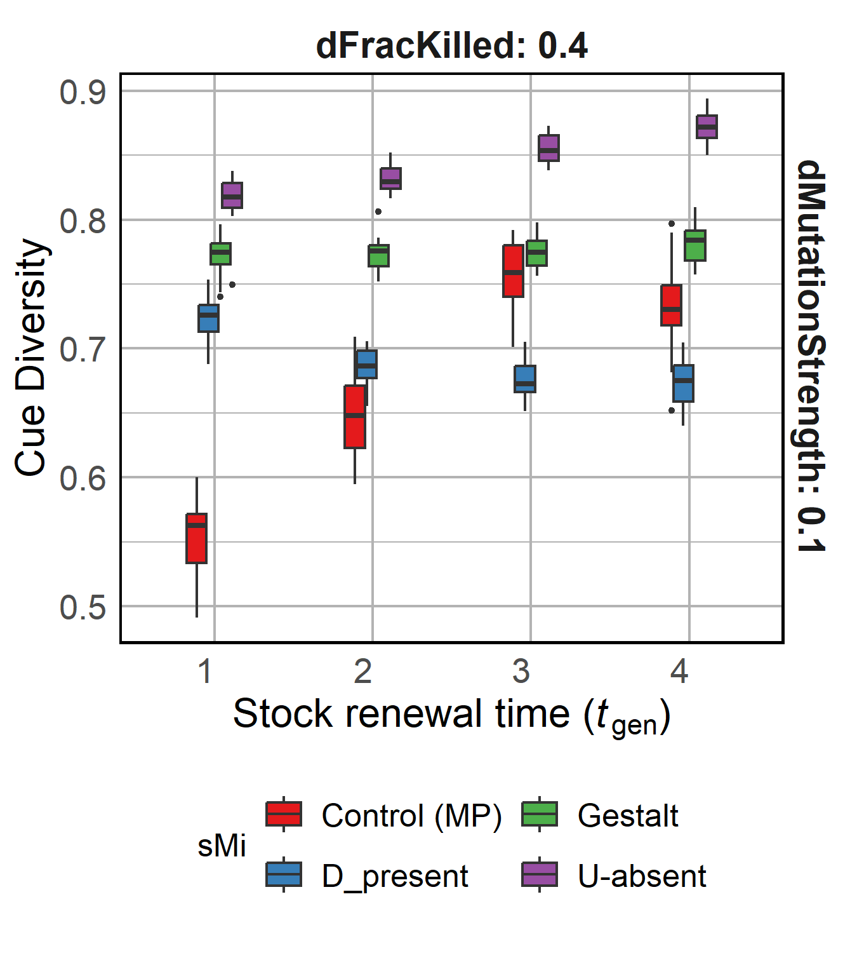
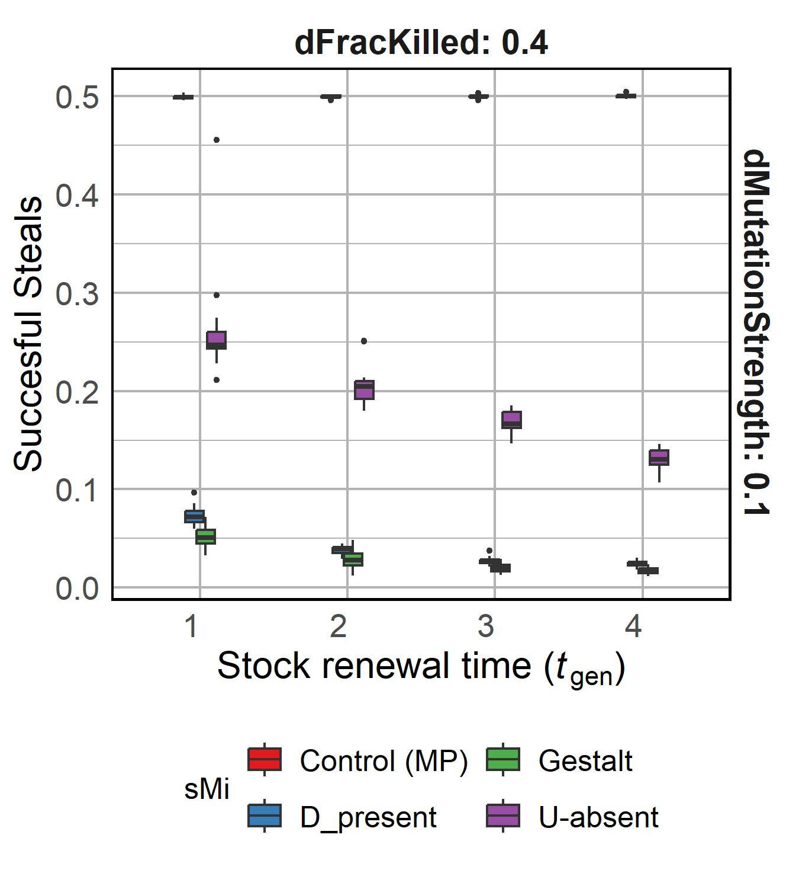
R2: Co-evolving systems can relieve pressure on each other
Decreasing food availability
Decreasing food availability
Extremely paramount to consider co-evolving systems, may drastically change the model results
Notes:
< Mention low stealing value > < Non significant >

Slide 18
Take home messages (academic + social)

Slide 19
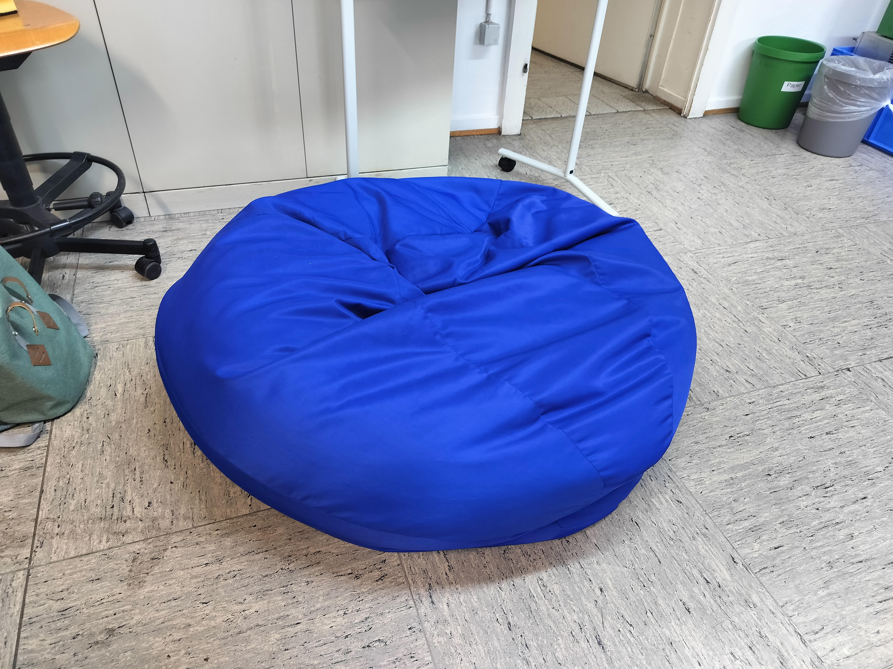
Thanks and questions ☺?

Slide 20
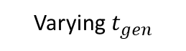
Controls and parameters varies
Can cue diversity persist under the scope of our assumptions contrary to what Crozier’s paradox says?
Average Cue Diversity
Model Control (M)
Varying $t_{gen}$
Varying metabolic cost of CHC production
Average Cue Abundance
Controls
Population Control (P)
Metrics collected
Conditions explored
Success rate of stealing attempts
Varying selection strength
Varying mutation rate for cues
Drift Control
Continuous food regeneration
#initial lineages surviving

